Slide 1

A Content Management Framework for Symfony

Slide 2

About me
Karsten Frohwein
Developer since 2001
Symfony > 3.x
sulu.io
https://www.xing.com/profile/Karsten_Frohwein/cv
https://www.linkedin.com/in/karstenfrohwein/
https://www.kuechengoetter.de/
https://www.orizon.de/de

Slide 3
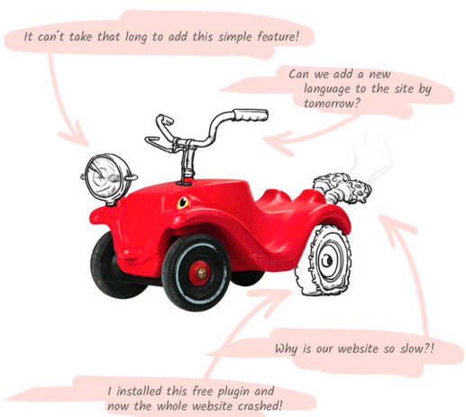
What is a CMS?
A way to let the customer create a website without any knowledge about the www, writing or design that can solve all™ problems
...
Something weird!
The end of the CMS is nigh!
Raise of the frameworks

Slide 4
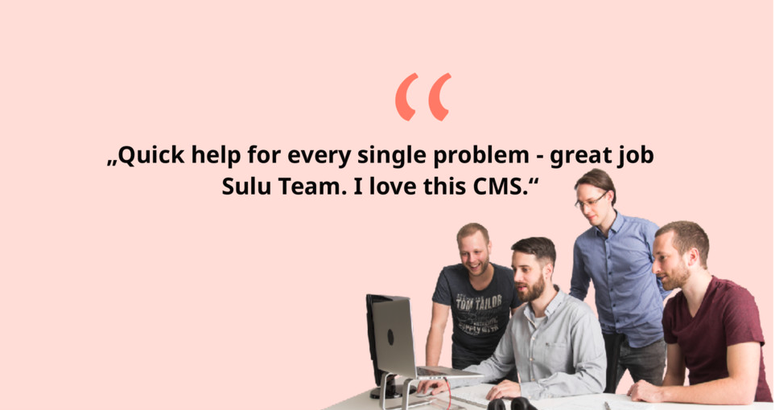
About sulu.io
Created to be as much of a framework-bundle as possible
No config in the Database!
Versatile
Own your code
Close to symfony as possible
sulu GmbH
From Austria with love

Slide 5

What sulu NOT is!
Easy to setup
  Complex stack that is build to use various daemons
  Relies on CLI commands
  No 5 minute setup
100.000 plugins of dubios code quality
  Symfony bundles but no plugins
Something for very small websites
  wordpress
  static site builder
You have to know symfony!

Slide 6
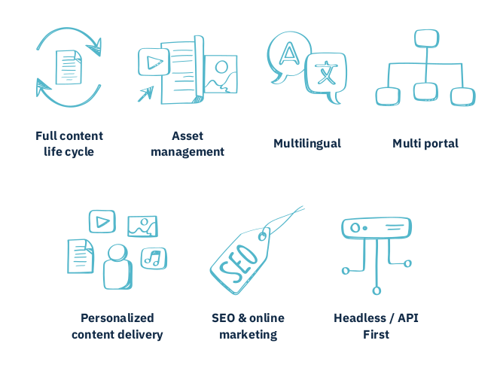
CMS

Slide 7
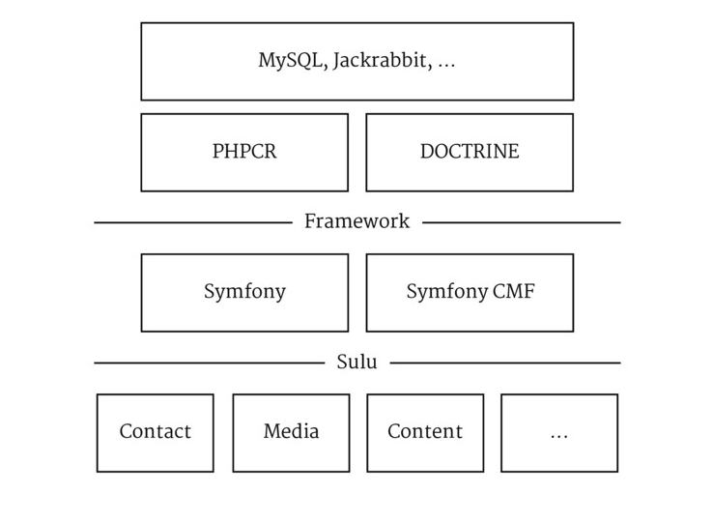
Dev Stack
Symfony to its core
Doctrine Entities
Standard Router
The sulu bundles will help and support you
symfony proxy = Caching & ESI

Slide 8
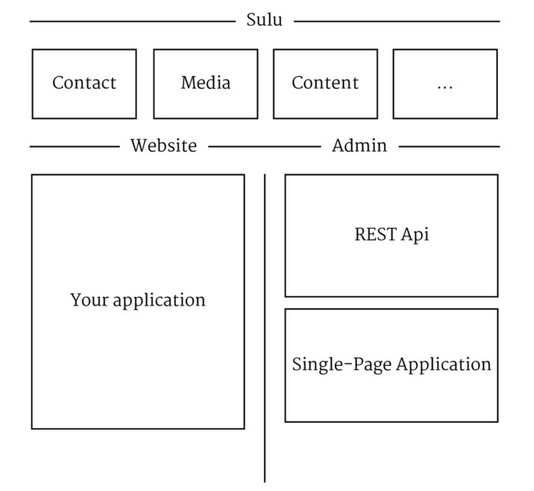
Application Stack
You may use Twig
Or just FOSRest
Do as you like there are no limits!

Slide 9

Content Management Framework (CMF)
Symfony CMF Routing Bundle
Chain Routing
Dynamic Routing
http://symfony.com/doc/master/cmf/bundles/routing/index.html

Slide 10





Setup & Stack
composer create-project sulu/sulu-minimal my-project -n
PHP > 7.1
  ext-dom
  ext-fileinfo
  ext-iconv
  ext-json
  ext-SimpleXML
Elastic Search 5.6
  Not a hard dependency
  but I recommend it

Slide 11

PHP Content Repository (PHPCR)
Comes from Java - JCR
NoSQL in MySQL
When to use PHPCR
For hierarchical navigation structures
For compound data that belongs together.
i.e. a web page with attached files or translations
You need to version content
You want full text search

Slide 12
Webspaces
Basic Setup
Multiple Webspaces & Portals & Environments
Multi Lingual
....
<resource-locator>
<strategy>tree_leaf_edit</strategy>
</resource-locator>
<portals>
<portal>
<name>example</name>
<key>example</key>
<environments>
<environment type="prod">
<urls>
<url language="en">example.org</url>
</urls>
</environment>
<environment type="dev">
<urls>
<url language="en">example.lo</url>
</urls>
</environment>
</environments>
</portal>
</portals>
...

Slide 13
Templates & Content Types
<!-- ... -->
<template>
<section name="organizationalDetails">
<!-- ... -->
<properties>
<property name="article" type="text_editor">
<meta>
<title lang="en">Article Content</title>
</meta>
</property>
<property name="startDate" type="date">
<meta>
<title lang="en">Start Date</title>
</meta>
</property>
<property name="endDate" type="date">
<meta>
<title lang="en">End Date</title>
</meta>
</property>
</properties>
</section>
<!-- ... -->
</template>
XML definitions
Various preset content types
  Category list
  Checkbox
  Color
  Date
  Email
  ...
Block System
Snippets

Slide 14
Twig
Just use twig as you know it
sulu doesn’t care about your JS & CSS!
Set it up with no limits as you like
Use the tools / frameworks that do the Frontend Job
Still use Webpack Encore :)
{% extends "AppBundle::master.html.twig" %}
{% block content %}
<h1 property="title">{{ content.title }}</h1>
<div property="article">
{{ content.article|raw }}
</div>
<div property="startDate">
{{ content.startDate }}
</div>
<div property="endDate">
{{ content.endDate }}
</div>
{% endblock %}

Slide 15

2.0 Backoffice in React
Responsive
Responsive Preview
High Speed
Highly Interactive
All Rest-ified

Slide 16
Configure your backend from PHP
XML Configs
Controller with REST & HATEOAS
Highly customizable
  creating new views
  creating new fields
  creating new toolbar buttons
  creating new preview
https://github.com/sulu/ExampleEventBundle

Slide 17
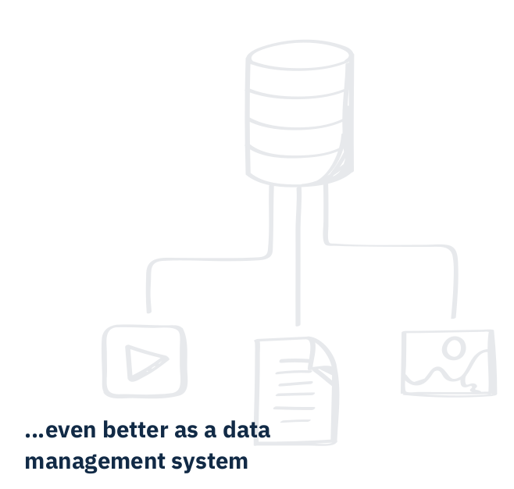
2.0 Bring your own entity
sulu.io the Data Management System
Connect any Entity by REST & HATEOAS
Browse standard sulu lists
XML Config to use sulu Content Types to provide and alter the data

Slide 18
Symfony Event System
sulu heavily relies on the symfony event system!
Saving and loading content resides in events!
vagrant@sulu:/var/www/vhosts/orizon$ bin/adminconsole sulu:document:subscriber:debug
Specify one of the following event names to display the subscribers:
+----------------------+
| Event |
+----------------------+
| persist |
| hydrate |
| remove |
| refresh |
| copy |
| move |
| create |
| clear |
| find |
| reorder |
| publish |
| unpublish |
| remove_draft |
| flush |
| query.create |
| query.create_builder |
| query.execute |
| configure_options |
| metadata_load |
| restore |
+----------------------+

Slide 19
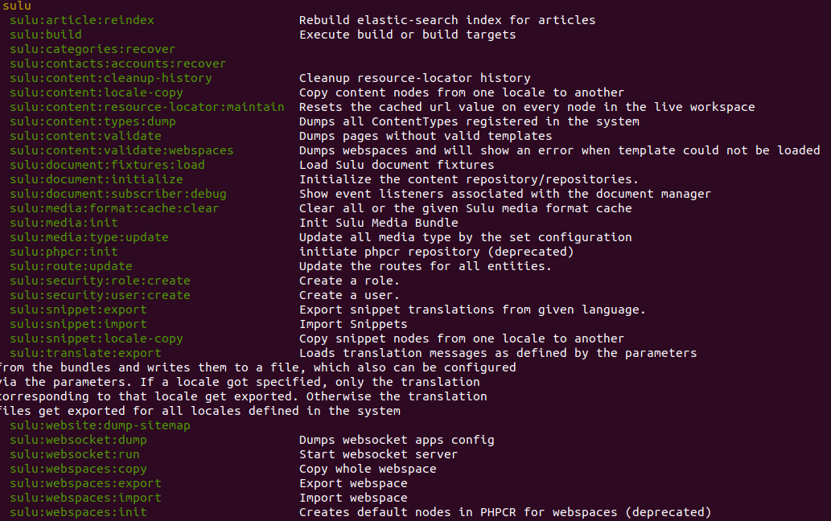
CLI Commands
sulu:build
sulu:article:reindex
massive:search:reindex
sulu:phpcr:init

Slide 20

Bundles
Form Bundle
Article Bundle
Community Bundle
Automation Bundle
Redirect Bundle
Theme Bundle

Slide 21

Thank you!
It’s a CMS & Framework
You control your code
Strict separation between config and content
Helps you solve everyday tasks
Open Source
#Slack Channel
https://sulu.rocks/en
https://sulu.io/en/contact

